Slide 1
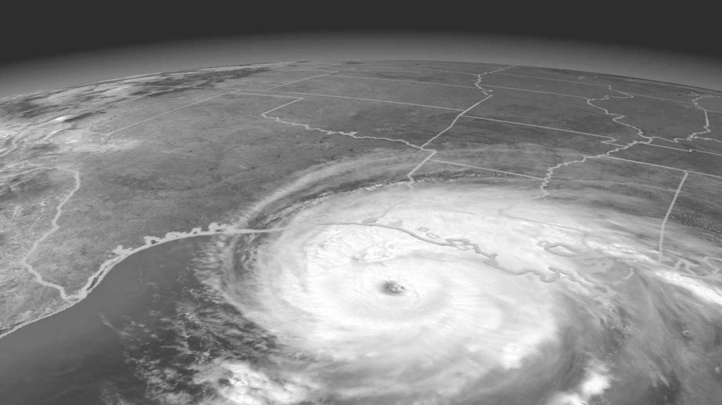
hurricanes

Slide 3
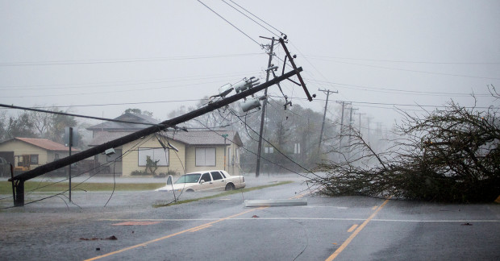
Objectives
Recognize hazards associated with cleanup in the aftermath of hurricanes.
Assess hazards of assigned tasks to ensure safety and health of site workers.
Identify precautions and control measures to control identified hazards.

Slide 4
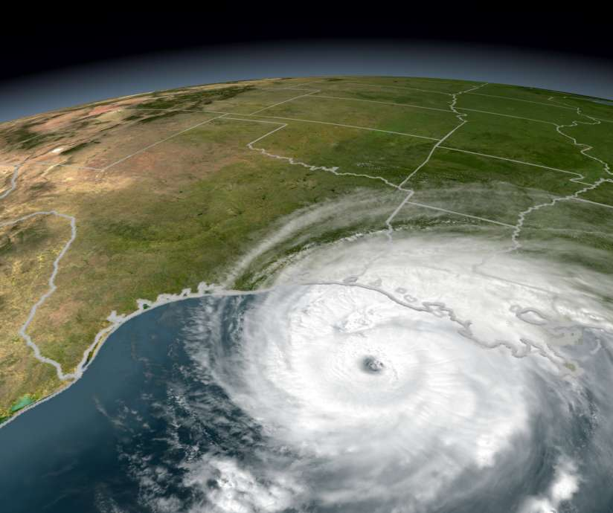
fact
Winds in excess of 74 mph reaching up to 160 mph.
Typically spawn tornadoes, flash floods, and heavy rains.
Can trigger storm surge that can devastate coastal communities.
Average 17 deaths.
60 + injuries reported.

Slide 5
Hurricane Hazards
Electrocution Hazards
Back feed Power
Hazardous Substance / Chemical
Chain Saws/Tree Removal
Motor Vehicle Safety
Fall Prevention
Construction Debris
Carbon Monoxide
Heat Stress
Mold

Slide 6
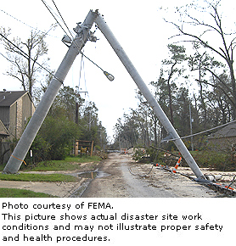
Response Worker Precautions
Electrocution Hazards
Do not clean up or work near downed unless utility workers have turned off the power and grounded lines.
Do not enter flooded areas or touch electrical devices or appliances if ground is wet unless you know power off.
Back-feed Power
Treat all lines as "hot" unless you positively know they are no longer hot and are properly disconnected and grounded on both sides of the work area.

Slide 7
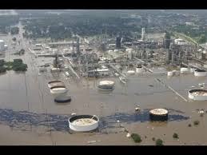
Response Worker Precautions
Hazardous Substance /
Chemical
If hazardous chemical containers are found or leaking materials are detected, take self-protective measures such as moving to a safe distance upwind and contact hazardous material response personnel for evaluation of the risk and removal.

Slide 8
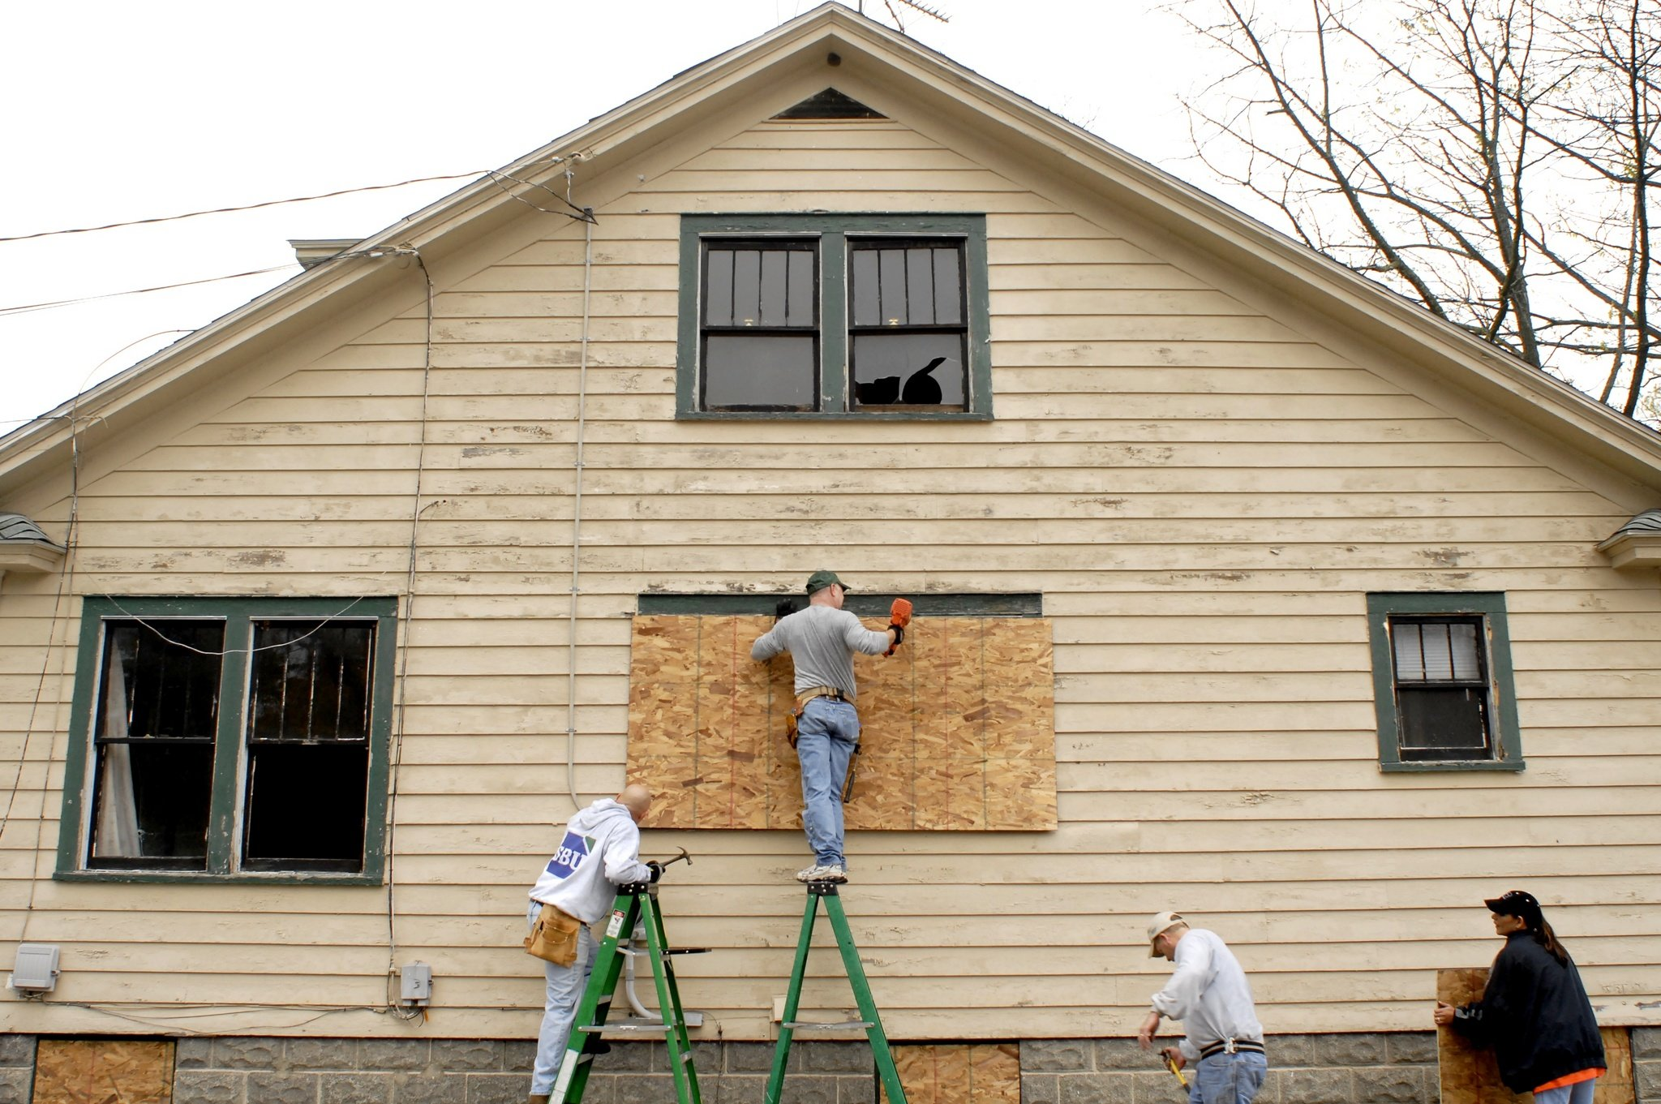
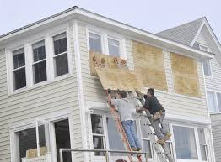
Response Worker Precautions
Fall Prevention
Use three points of contact, and do not overreach to the side of a ladder, and do not pull or push extensively.

Slide 9
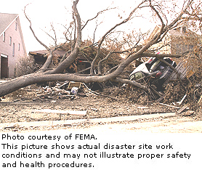
Response Worker Precautions
Chain Saws/Tree Removal
Wear proper clothing when using a chain saw.
Structural Instability
Limit access/set up controlled access zones until the structure's stability and structural integrity are known.
Ensure competent person evaluates structure's stability when access is necessary.
Install temporary structural support (shoring, bracing) adequate to protect response and recovery workers.

Slide 10
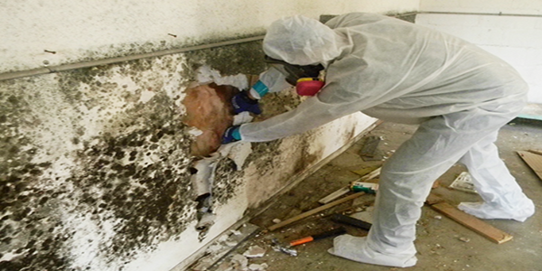
Response Worker Precautions
Mold
Mold exposure and damp indoor environments have been associated with health symptoms including asthma, allergies, and respiratory infections.
Carbon Monoxide
Learn to recognize symptoms and signs of CO overexposure: headache, nausea, weakness, dizziness, visual disturbances, changes in personality, and loss of consciousness..

Slide 11
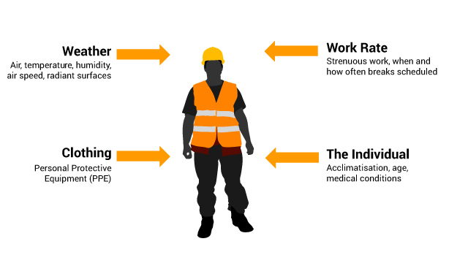
Response Worker Precautions
Heat Stress
Exposure to extreme heat can result in heat-related illnesses and injuries. Heat-related illnesses include: heat stroke, heat exhaustion, rhabdomyolysis (muscle breakdown), heat cramps, or heat rash.
Motor Vehicle Safety
Take measures to ensure workers in vehicles can carry out their response mission safely.

Slide 12
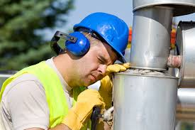
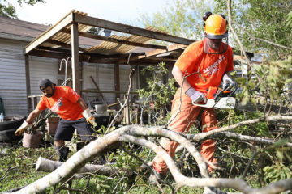
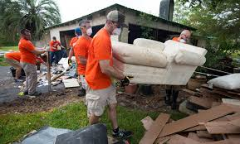
activity
List a minimum of FOUR hazards to site workers involved in cleanup following a hurricane?
Electrocution Hazards
Back feed Power
Hazardous Substance / Chemical
Chain Saws/Tree Removal
Motor Vehicle Safety
Fall Prevention
Construction Debris
Carbon Monoxide
Heat Stress
Mold

Slide 13
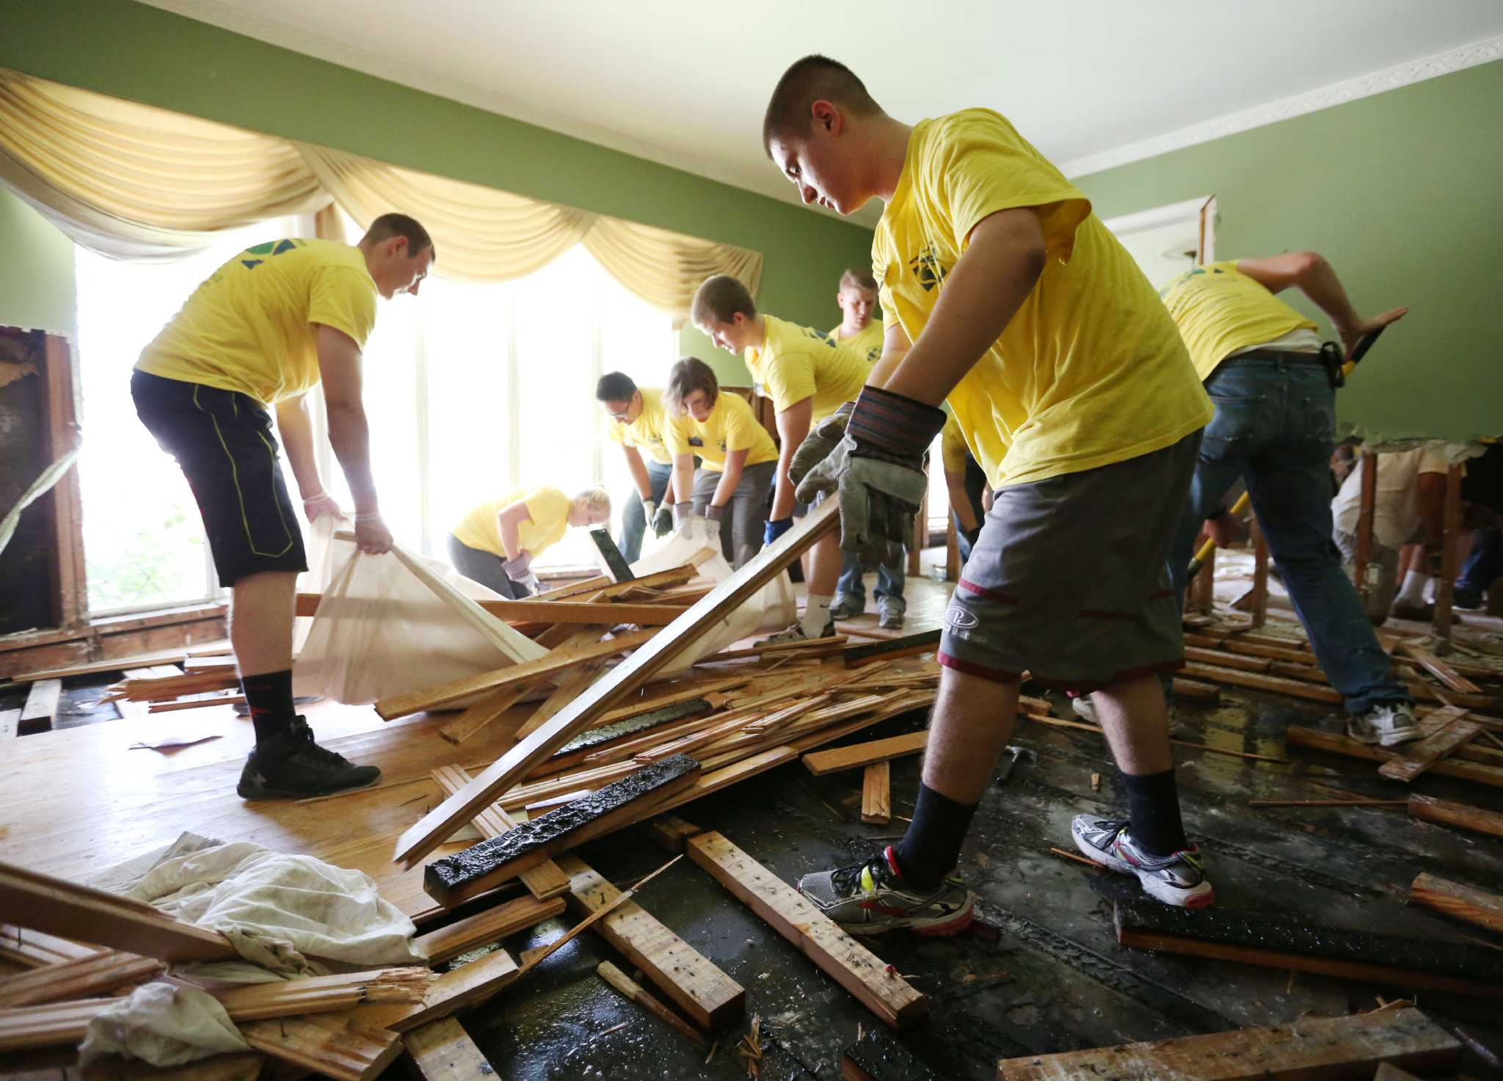
activity
Use the Safety and Health Checklist to complete:
Hazard Recognition
Probability
Severity
Risk
Apply the Hierarchy of Health & Safety Controls

Slide 14
References
Hurricane eMatrix:
https://www.osha.gov/SLTC/etools/hurricane/index.html
NIOSH:
https://www.cdc.gov/niosh/topics/emres/flood.html
FEMA:
https://www.fema.gov/news-release/2017/10/03/proper-cleanup-following-hurricanes-can-reduce-mold-and-minimize-health

